Slide 1
Level 6 Group 4

Slide 2
The brief
Game of Emergence
Multiple solutions
Single Player
PC
[INSERT IMAGE OF GAME]

Slide 3
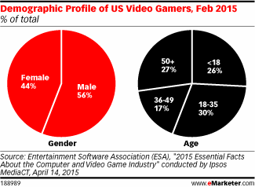
Demographic / Psychographic
Males
Aged 15-25
Students
Management / City simulation game
Notes:
The game will appeal more to males than females due to the nature of males in general enjoying the ability to master a game’s systems and success through trial and error. These two aspects come hand in hand. Players can only achieve the mastery they seek through the trial and error of playing the game to learn what does and does not work. Furthermore, males are more predisposed to enjoy destruction and violence, which is an integral part of this game, destroying the local wildlife in order to build a colony. Whereas females tend to prefer a more nurturing game which explores the richness of human emotion[Schell, J.(2014)]

Slide 4
Monster Miner
Colony Simulation
Resource Management
Overhead camera
Survive and Expand
[INSERT IMAGE OF MONSTERS]

Slide 5
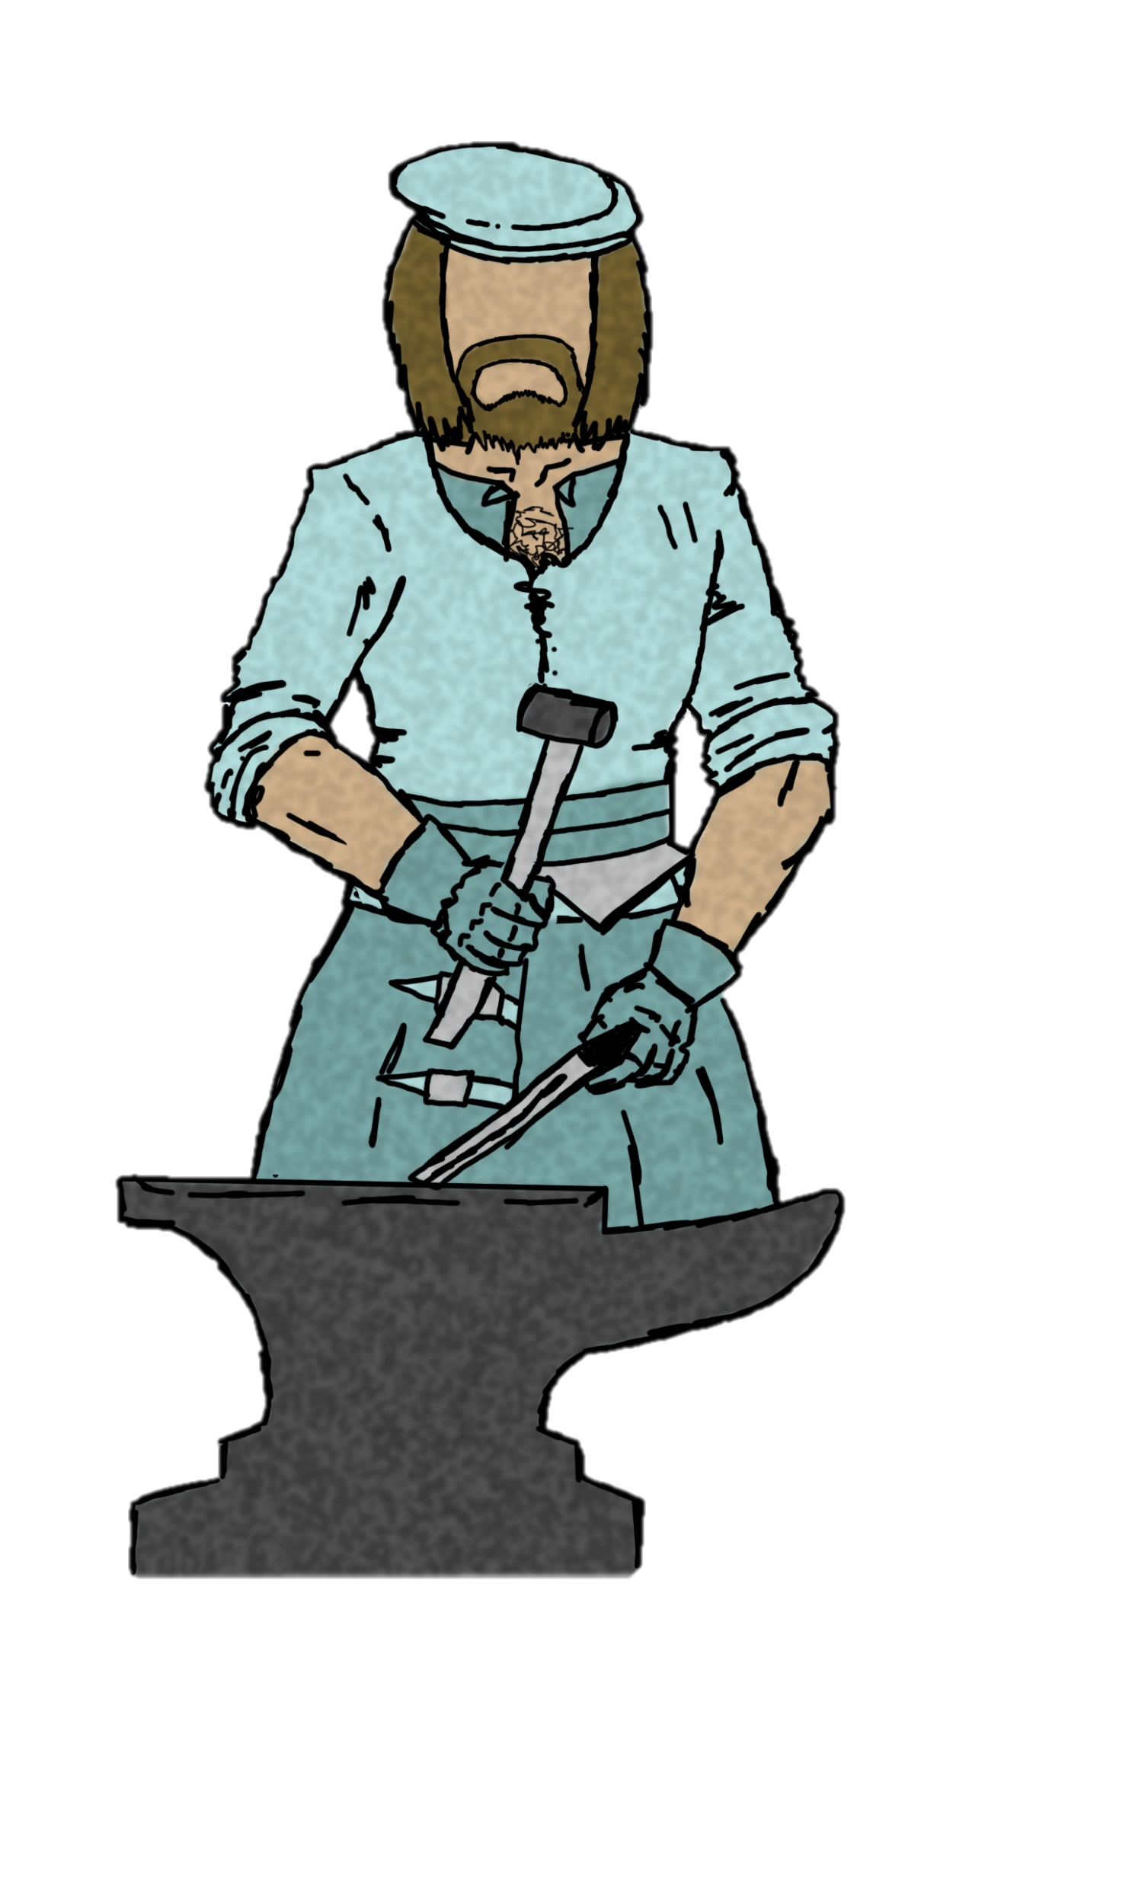
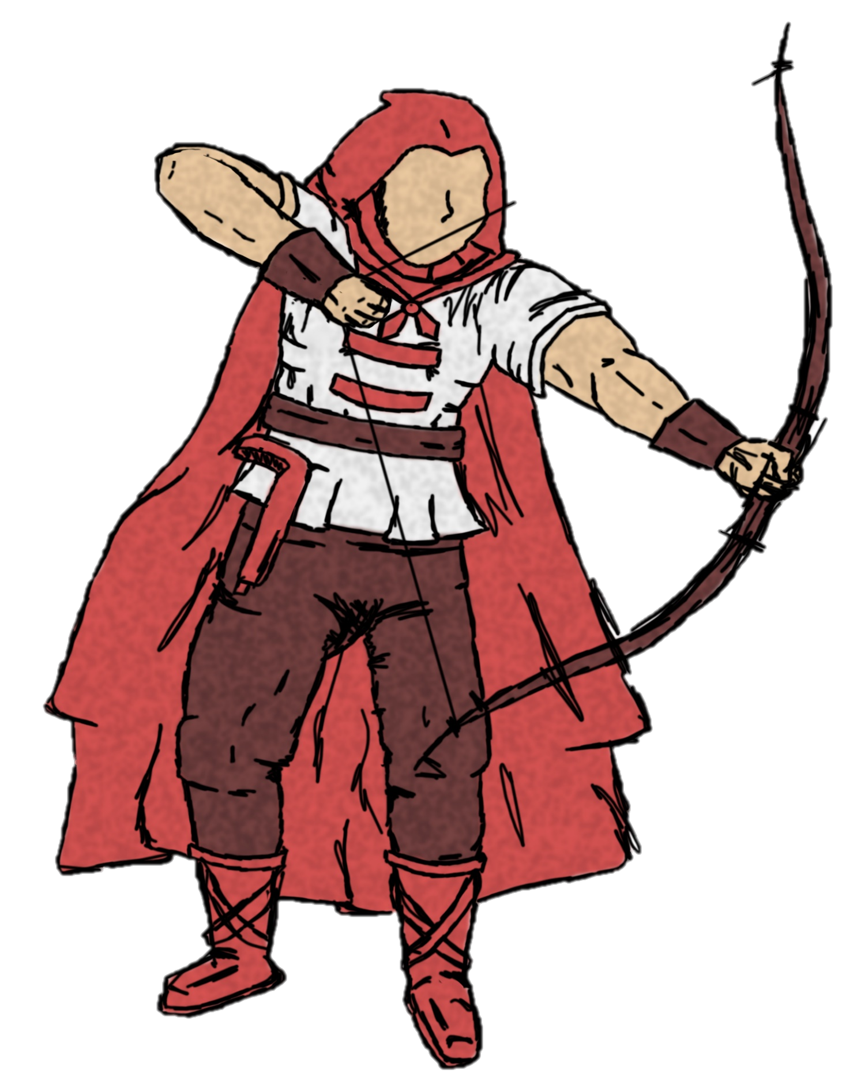
Colonists
Hunters
Scout
Crafter
Farmer

Slide 6
What the player does
Manage population
Select monster to hunt
Grow city
Upgrade units
[INSERT IMAGE OF BUILDINGS]

Slide 7
Main Game loop
[INSERT VIDEO OF MAIN GAME LOOP]

Slide 8
Playtesting

Slide 9
STRENGTHS AND WEAKNESSES
Strengths:
Replayability
UI iteration
Design Iteration
Weaknesses:
Assets not completed
Balancing
Polish Programming
UI Implementation
Colonist Clothing and Weaponary

Slide 10
Emergence and replay ability
[INSERT IMAGES OF TERRAIN]
Rewards
Emergence
Attachment to town and NPC’s
Extrinsic and intrinsic motivation
-Extrinsic: Competing with friends, aiming for rewards.
-Intrinsic: Drive to have their ideal colony.
Notes:
Rewards must be fulfilling yet leaving the player wanting more. We will develop a reward system that is not only refreshing but keeps the player asking for more.
Emergence will be from the interactions the player has with not only his environment but the colony itself, using tropes that players can identify and latch onto such as family and friendship roles that the NPC’s will present themselves with, and the ability to assign NPC’s roles and even their names to personalize your colony and emerge the player in their own hand crafter world.

Slide 11
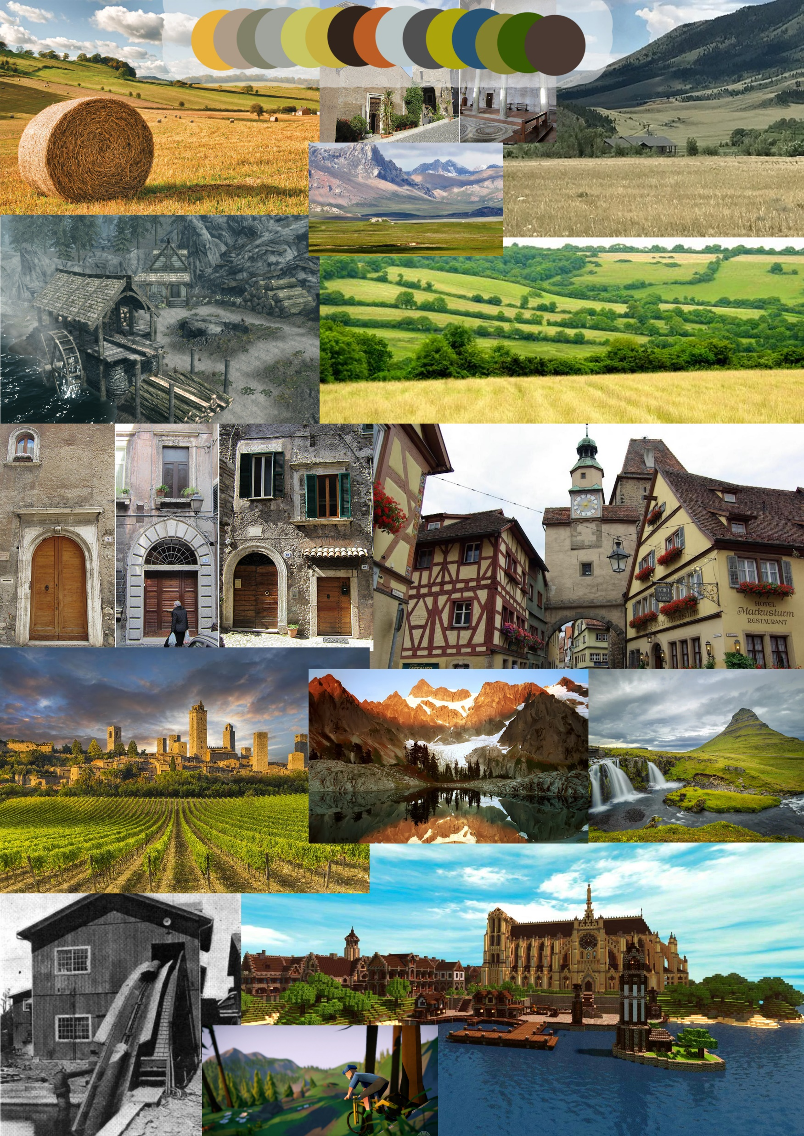
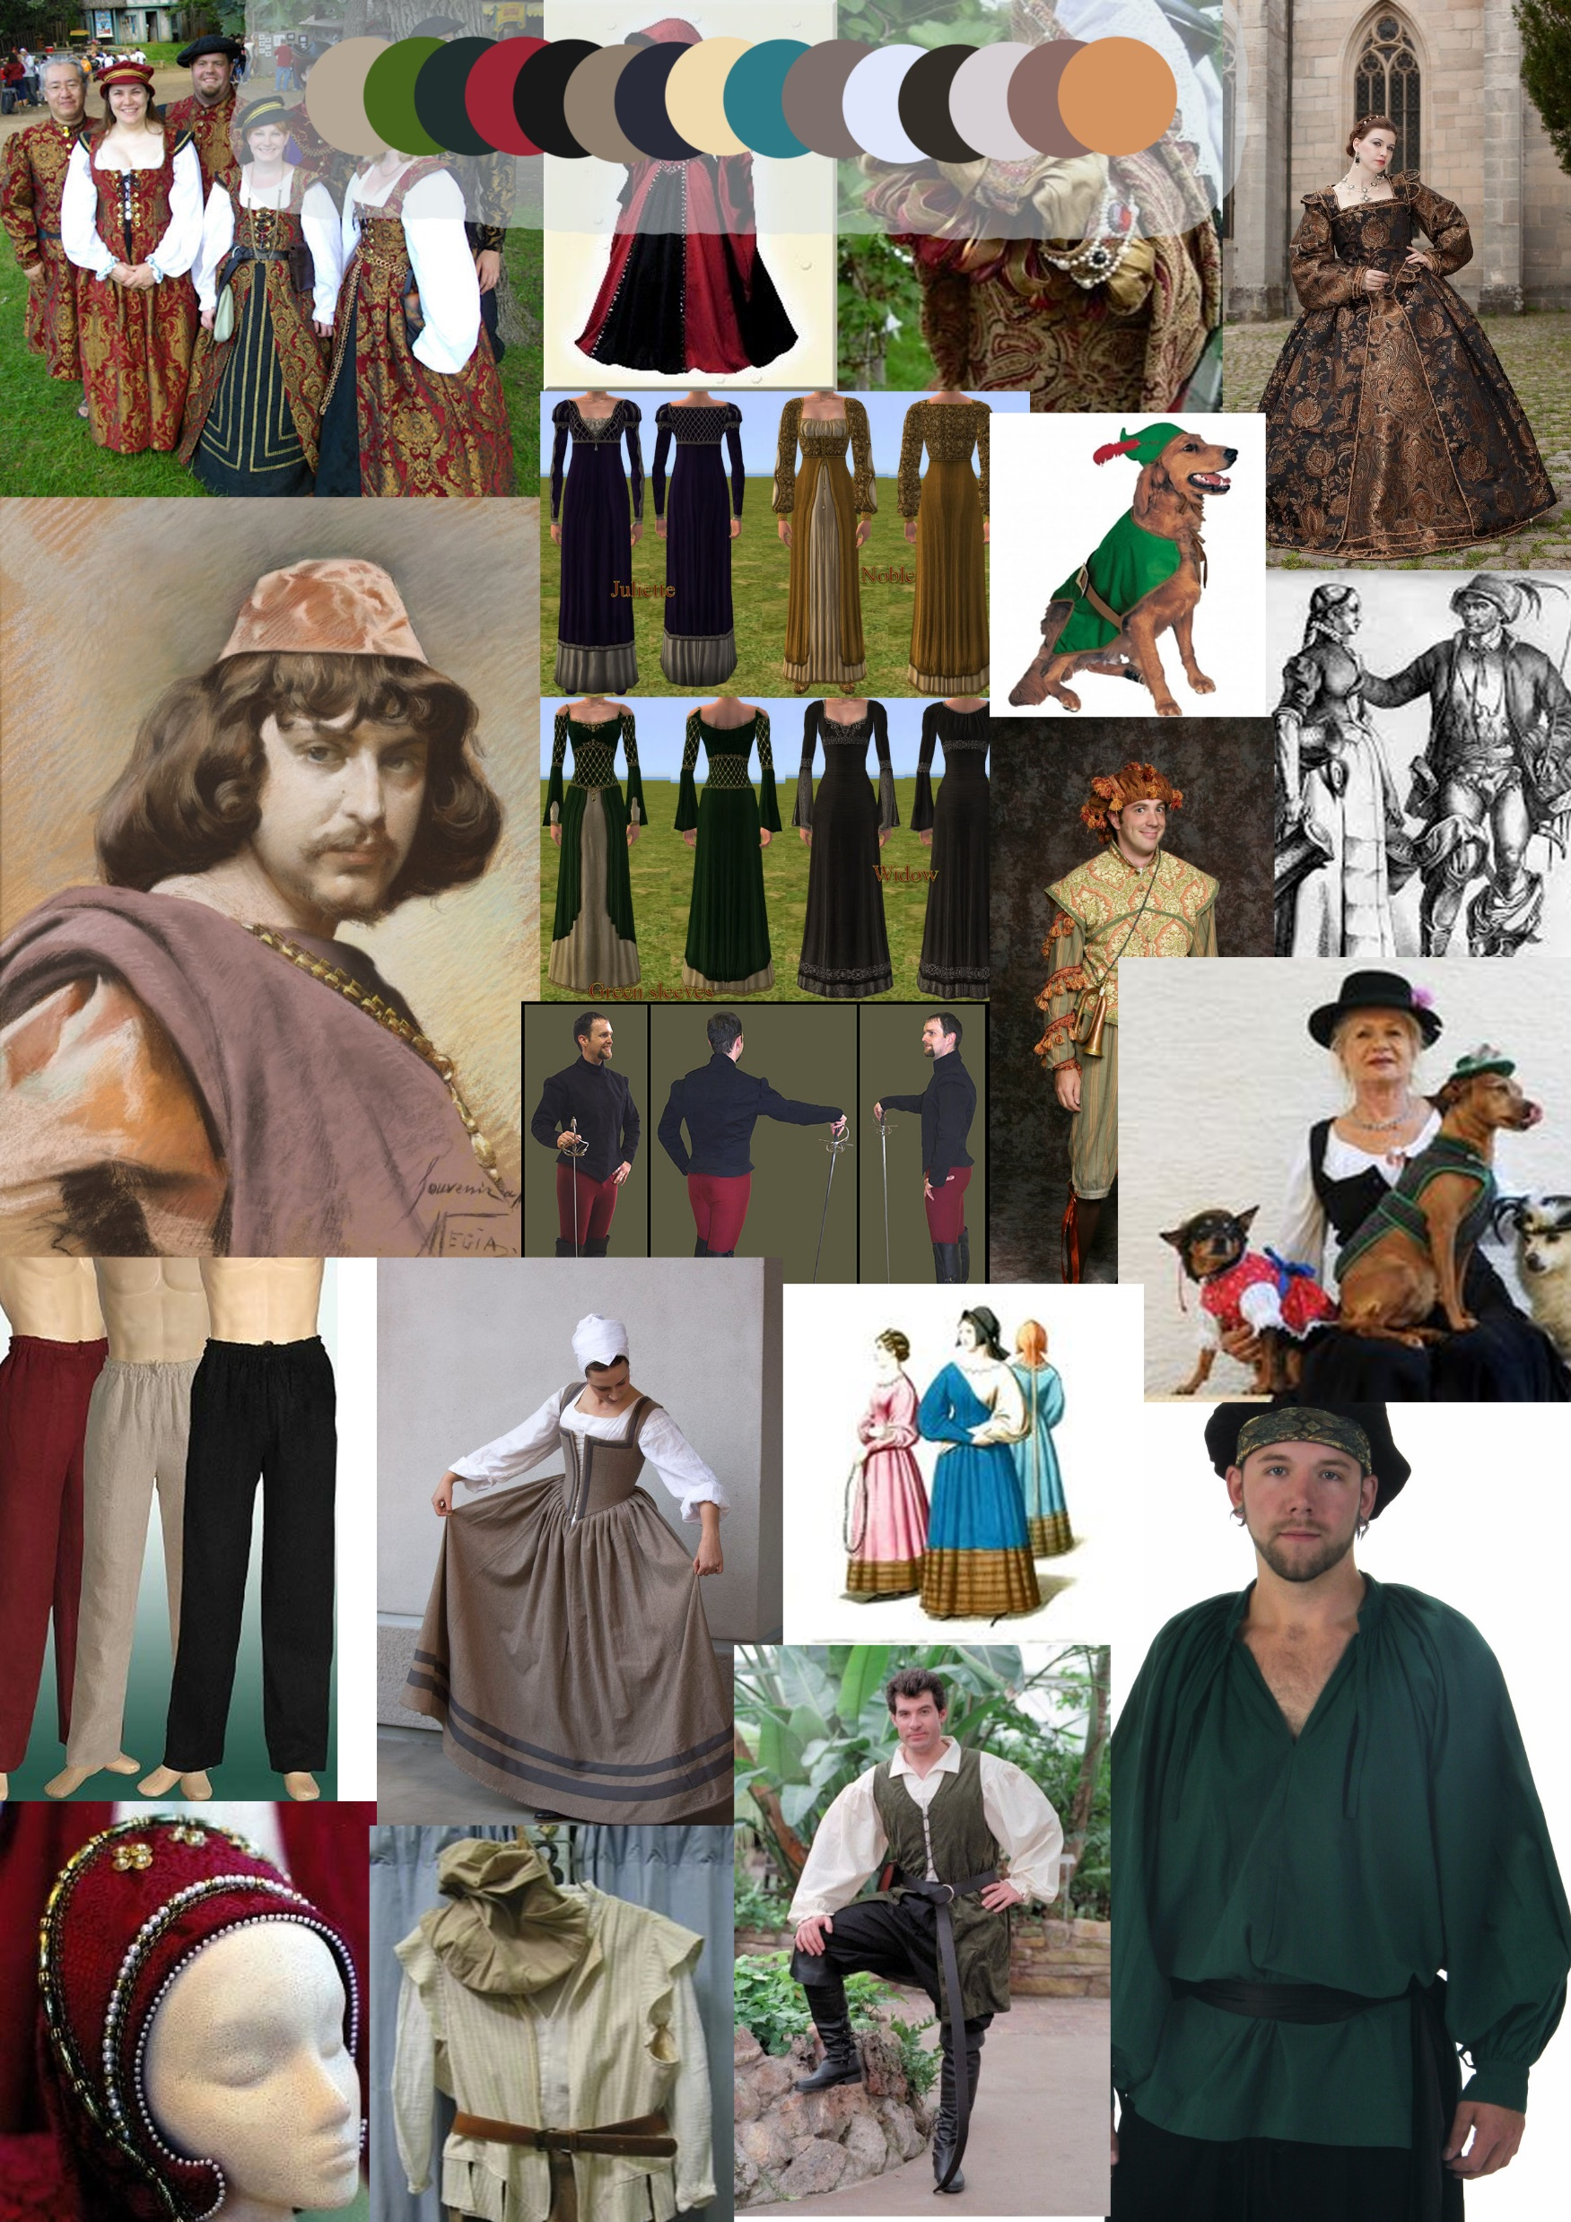
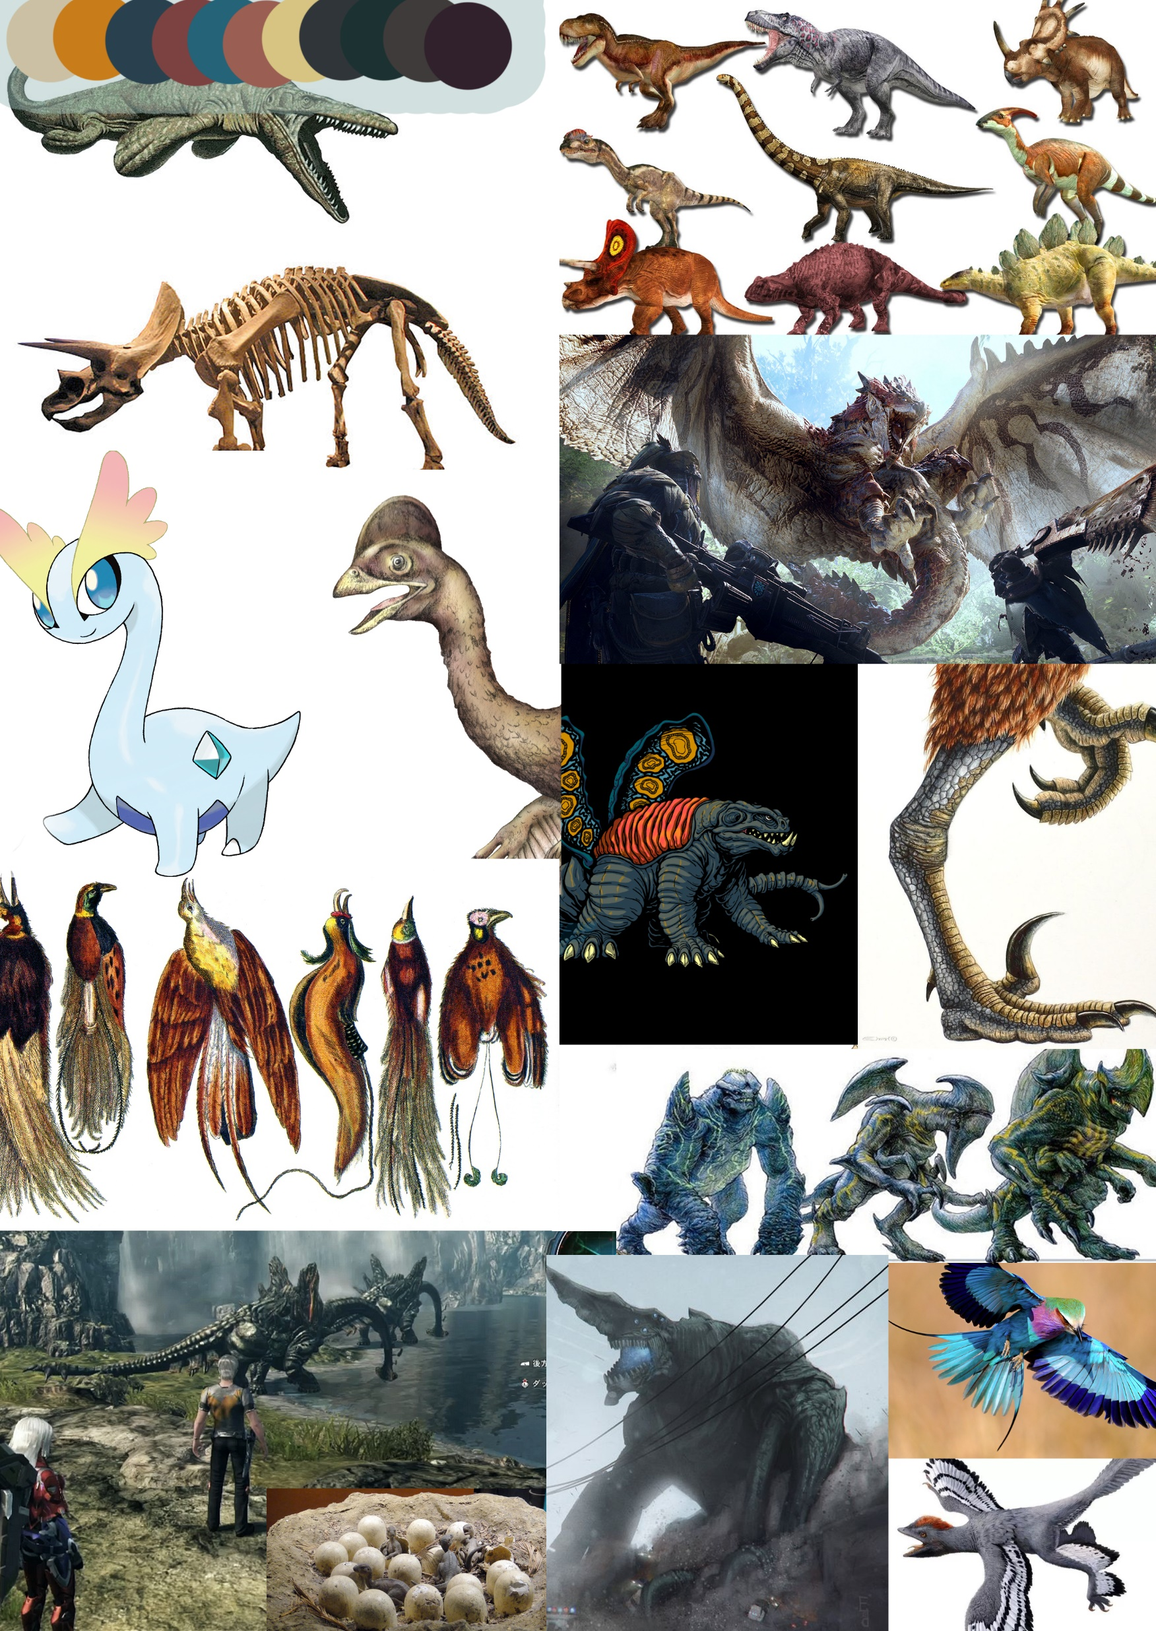
Research and design methods

Slide 12
Art Assets (Colonists)

Slide 13
Art Assets (Buildings)

Slide 14
Art Assets (Monsters)

Slide 15
Christmas Tasks
Colonist Recruitment
Tile Generation
Save and Load
Monster Behaviour
UI Art Work
Colonist Clothing and Weaponry

Slide 16
Questions?

